Slide 1
Tax Refund Calculator iPhone app
By: Tuna Erdurmaz
Date: 12th of February 2010
Supervisor: Paul Barry

Slide 2
Red Oak Tax Refund Calculator iPhone app
The aim of my project is to develop a prototype for a comercial iPhone app for the Red Oak Tax Refunds Company of their Tax Refund Calculator.
The calculator will be formed to give the estimated tax refund of an user.

Slide 3
This calculator is aimed at PAYE income tax payers and covers most scenarios.
Tax Refund Calculator as an iPhone app will play a significant role to encourage the customers to Red Oak to get a full Tax Refund Assessment.

Slide 4
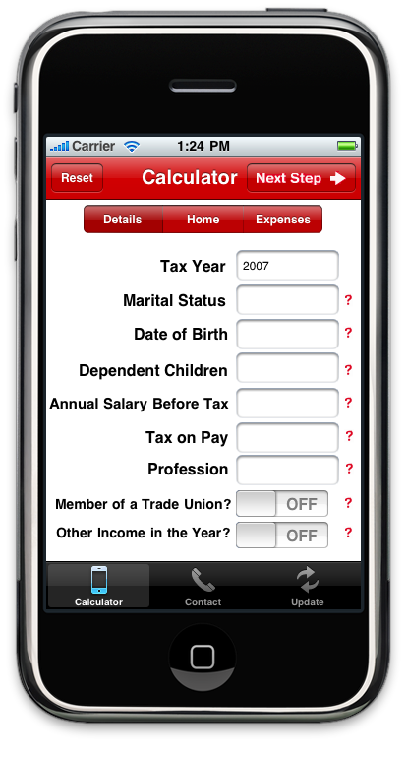
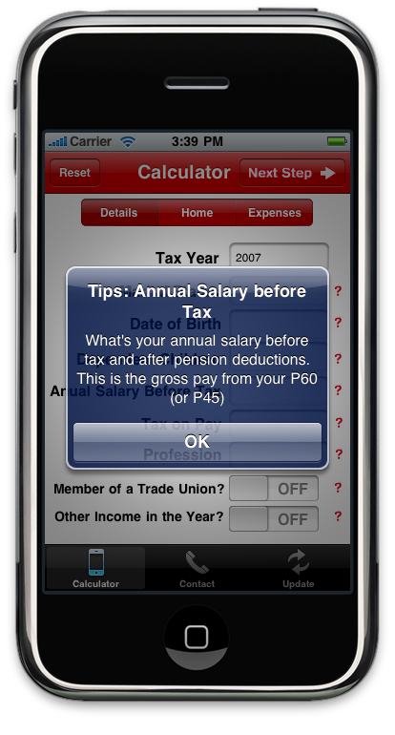
Overview

Slide 5
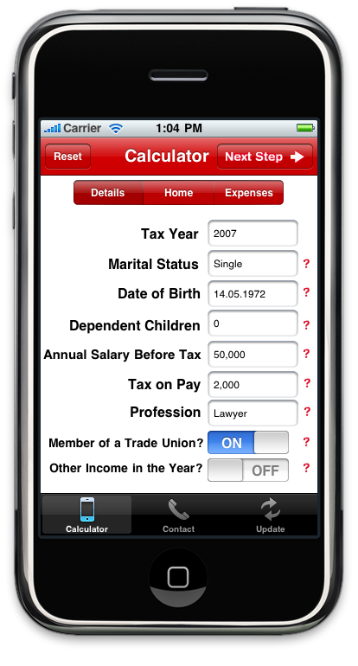
Step by step Calculator
This screen shot is the first step of the calculator called "Details" that allows the user to enter personal income tax information.
The user can either proceed to next step by touching the "Next Step" button or by using the segmented control.

Slide 6
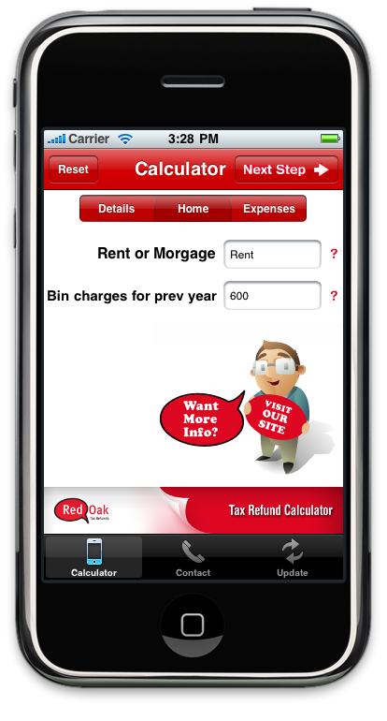
Step by step Calculator
This screen shot is the second step of the calculator called "Home" that allows the user to enter information about principle residence.
"Reset" button is also provided, if the user wishes to reload the calculator.

Slide 7
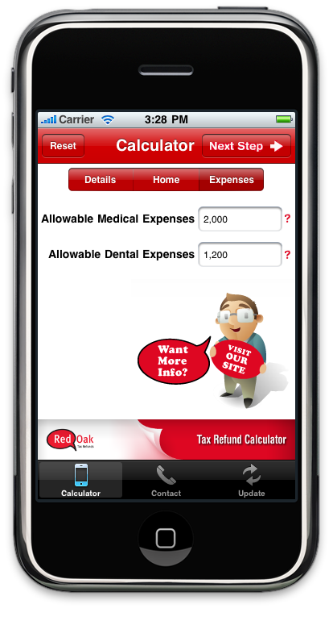
Step by step Calculator
This screen shot is the last step of the calculator called "Expenses" that allows the user to enter information about allowable expenses.
This is the last step since whenever the user touches the "Next Step", the calculator presents the estimated tax refund of a user.

Slide 8
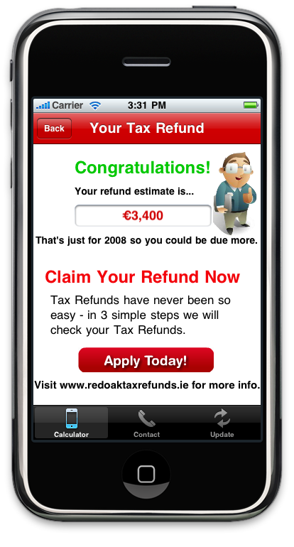
Step by step Calculator
Presents the estimated tax refund.
The user is allowed to come back to the calculator, when he/she wishes to make changes or starts a new calculation.
The user touches the "Apply Today" button in order to contact with the Red Oak Company.

Slide 9
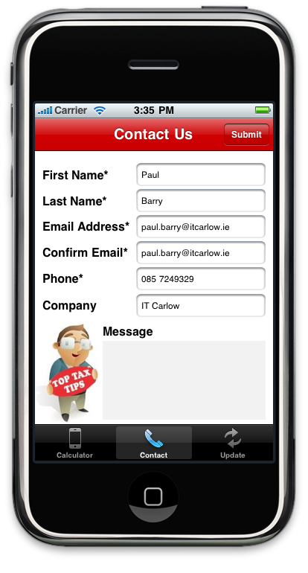
Step by step Calculator
Presents the contact form.
The user enters the information and touches the "Submit" button.
The user is allowed to cancel the transaction via switching the another tab bar item. ("Calculator" or "Update")

Slide 10
How this is different from a regular application?
Mobile applications are not just ported small desktop applications.
Mobile phones have a small screen and are task-focused.
Mobile phones have limited CPU and Memory.
Only one application can run at a time.

Slide 11
Objective-C
Object-oriented language.
Extension of the standard ANSI C language.
There is no garbage collection mechanism.
The programmer has to keep track of when to free allocated memory to not cause memory leaks.

Slide 12
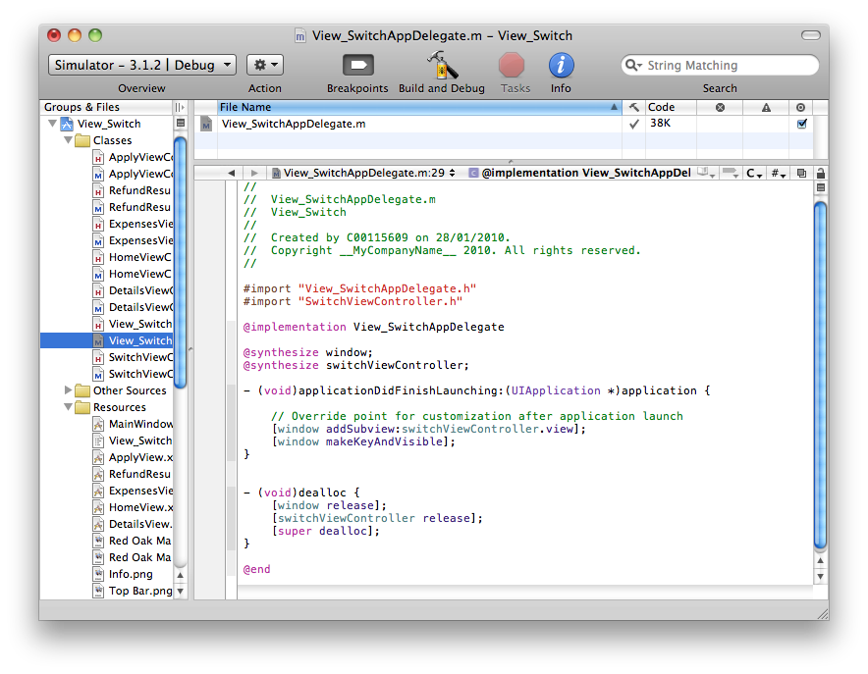
Objective-C

Slide 13
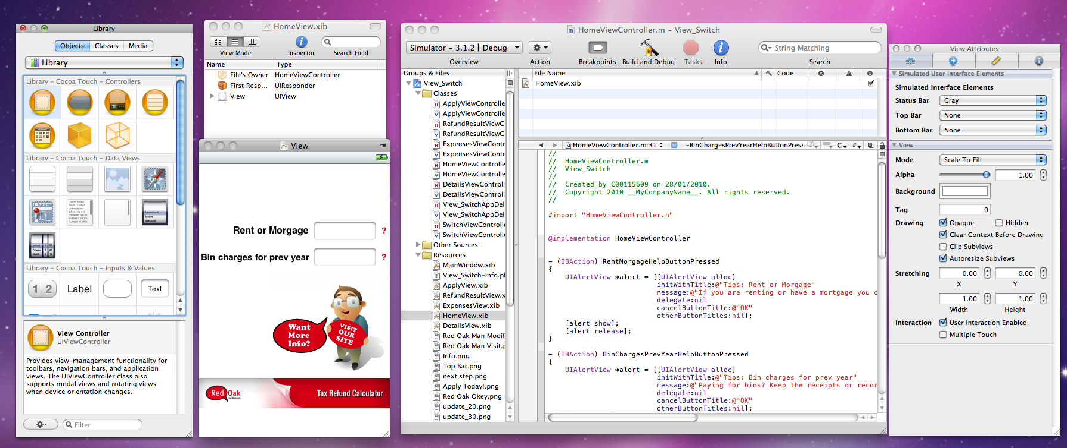
Xcode
These are the tools that I’m using for iPhone app development.
From left to right; Library, xib View, Xcode IDE and Inspector.

Slide 14
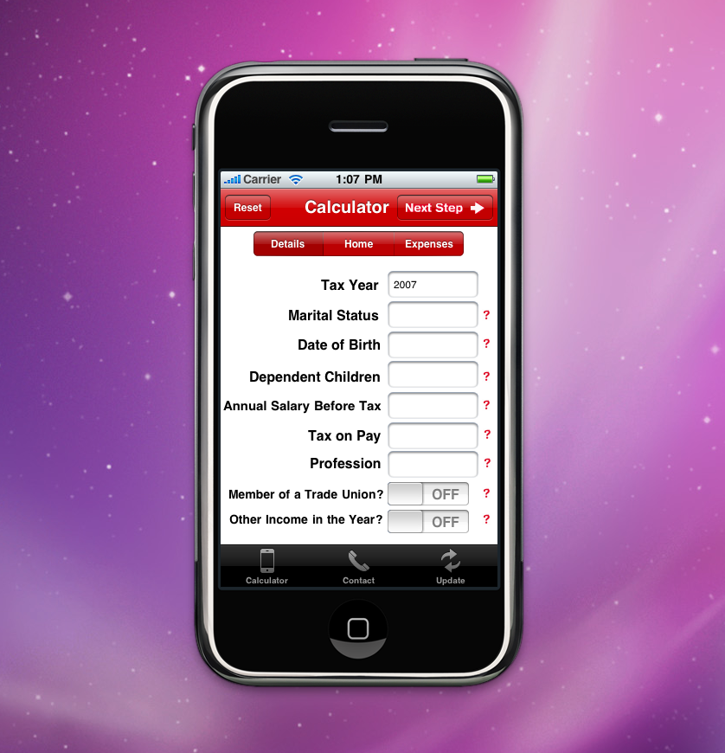
iPhone Simulator
The simulator which let me test most of the functionality locally on the iMac.

Slide 15
Technology Option
The environment my iPhone app is written in is Xcode.
Objective-C and Xcode are the only ways to develop an iPhone app.
Intel-based Mac is another compulsory technology.

Slide 16
Potential Issues & Challenges
Memory management is one of the challenges since iPhone has limited resources.
Currently testing relies on iPhone Simulator, however, iMac has lots of resources.
Testing on the actual device (iPhone or iPod Touch) will be more important due to reliability issue.
You have to enroll in the iPhone Developer Program and pay $99 to test in a real device and release onto the App Store.
Getting updates and the contact form functionalities working.

Slide 17
Remaining Works
I am working on connections between the tab bar items and the views. The rest of the connections were made.
I will start coding calculations soon.
I have to establish communication channel between the customer and the company via the contact form.
Update download functionality for the calculator has to be done.

Slide 18
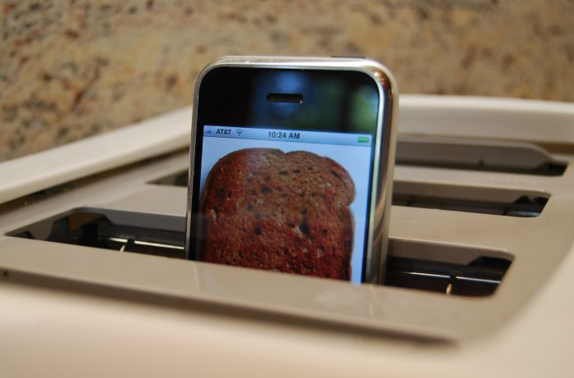
Any Questions?

