Slide 1
Web Based Music School Manager
Author: Aaron Redmond
Student ID: C00002396
Supervisor: Paul Barry

Slide 2
Topics
Project Description
Work Completed
Work To Do
Technologies
Challenges
Notes:
Tell em what your goin’ to tell em

Slide 3
Project Description
Real World Project
Carlow College of Music
Many Students
Many Teachers
One Administrator
Notes:
Talk about the challenges associated with running a music school

Slide 4
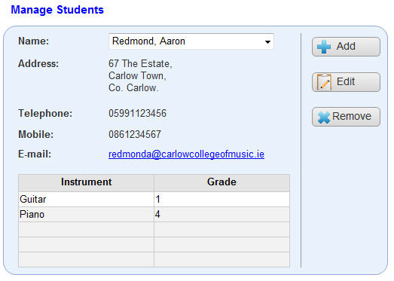
Project Description
Maintain School Data
Students
Teachers
Instruments
Rooms
Notes:
Talk about the different type of data associated with a typical music school

Slide 5
Project Description
Create School Timetables
Rooms
Class
Groups
Subjects
Teachers
Hours Per
Day
Days Per
Week
Notes:
Talk about the data required to compile a timetable and how long it takes to create by hand

Slide 6
Interview
Results
View data in one place
Replace the paper trail
Simplify timetabling process
It’s also Greener
Notes:
Talk about the results of the interview

Slide 7
Similar Products
FET
Paritor Academy
Prime Timetable
Notes:
Talk about available timetabling software

Slide 8
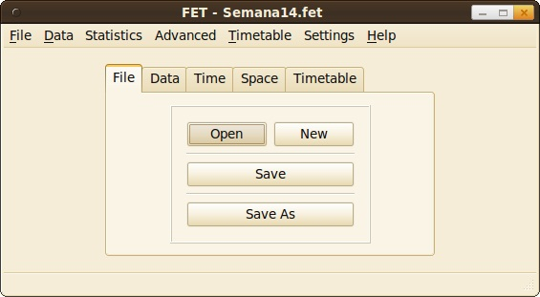
Work Completed
Timetabling Software
FET
Notes:
Talk about choosing a timetabling algorithm
Problem with Genetic Algorithm

Slide 9
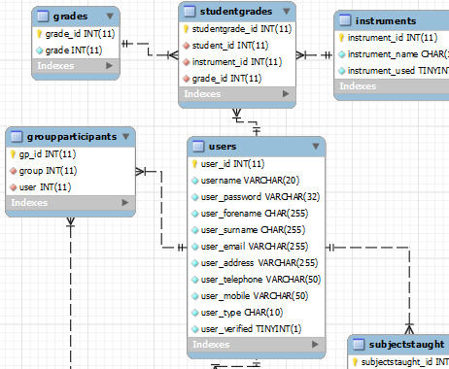
Work Completed
Data Design
Database
Structure
Notes:
Talk about choosing MySQL, as opposed to PgSQL, etc.

Slide 10
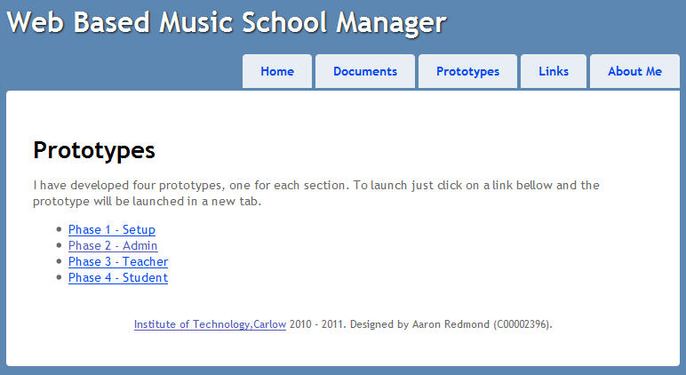
Work Completed
Application Design
Prototype
Notes:
Prototypes can be view via the projects website

Slide 11
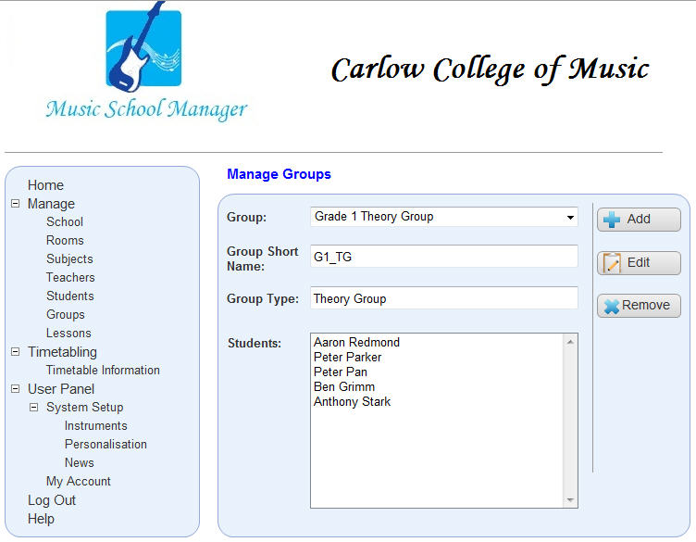
Work Completed
Notes:
Navigational Flow
Data for each screen

Slide 12
Work Completed
Percentage Completed
Research.............................95%
Coding.................................15%
Notes:
Research 95% as I’m learning every Day

Slide 13
Work To Do
Screen Design
Data Input and Editing
Implement Timetable Creation
Beautification (Make it look nice!)
Deployment
Notes:
1. Finish Basic Screen designs so I can enter and edit data.
2. Once I have data I can implement timetabling.
3.Get it looking professional.
4. How am i going to deploy it, a la Joomla ??

Slide 14
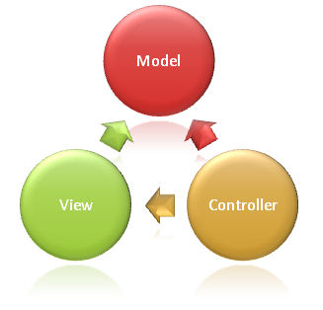
Technologies
Notes:
What else did I consider
Problems - Steep Learning Curve

Slide 15
Challenges
Implementing Timetabling
Will it Save Time
Confident
Notes:
Implementing timetabling – How long will it take?
Will the software do what is needed for a small music school
Confident – Oh Yeah

Slide 16
FIN !
Your Questions?
Notes:
The End. Ta Da....

