Slide 1
Caring App
Sean Matthews
21/03/2013
IT Carlow

Slide 2
What is it about?
The caring app is a web based app designed with the android platform in mind.
Aimed towards carers and the patients under their care.
Secure
Organisation
Communication
Customization
Notes:
There are four important aspects. Socc.
Security is a very important aspect of the project, it’s very important that users can trust that their information and the information (specifically their health details) of their patients will not be intercepted by malicious users.
The app will help users organise information regarding a patient in one place and will allow them to easily communicate with each other.
The app will allow for various customization options for patient usage in particular.

Slide 3
What is it about?
Will allow carers and patients to post notes, record readings and view patient reading graphs.
What does this mean for carers and patients?
Help to relieve workload.
Improve communication between carers.
Encourage better organisation.
Provide patients with more control.

Slide 4
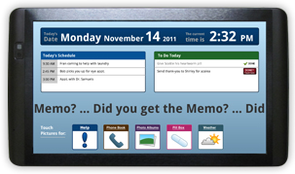
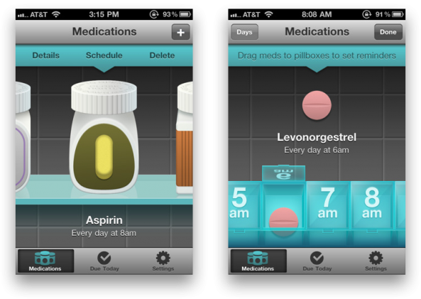
Research into similar products
Memotouch
Pillboxie
eCaring
iHealth MyVitals
Memotouch
Pillboxie
Notes:
Memotouch is an app that comes packaged with a tablet. It was the app I felt most closely represented what I wanted to do with the caring app project.
Pillboxie, IOS medicine manager app.
eCaring computer based application
iHealth MyVitals, IOS health reading manager app

Slide 5
Research into cloud platforms
Google App Engine
Amazon Web Services
Xeround
Salesforce

Slide 6
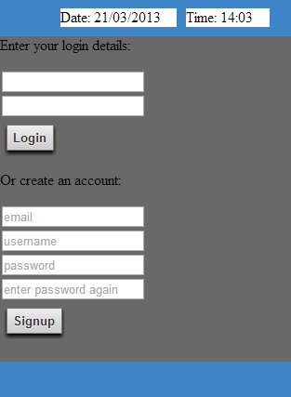
CURRENT SCREENS
Login Screen

Slide 7
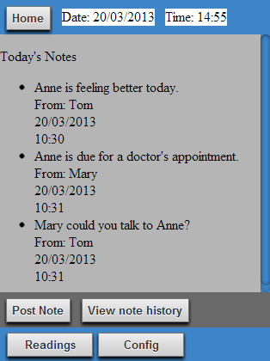
CURRENT SCREENS
Main Screen

Slide 8
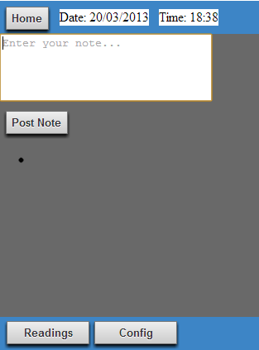
Current screens
Create Note

Slide 9
Currently working on
Create Readings
Reading Graphs (using jqplot)
Security
Minor additions

Slide 10
Technology Choices: Web App
HTML5
Javascript
CSS3
HTTPS protocol.

Slide 11
HTML5 Web App vs. Native
Considered the Native platform
However decided on HTML5 because…
Platform independence.
Worked with it on a previous project.
Wanted to further HTML5 and web development skills

Slide 12
Technology Choices: The Cloud
Google App Engine
Datastore
Python
Jinja2

Slide 13
GOOGLE APP ENGINE vs. other options
Considered other cloud based options.
However Google App Engine came out on top.
Easier to work with.
More freedom for student projects

Slide 14
Miscellaneous Technologies
JSON (Javascript Object Notation)
Jquery (Javascript library)
Jqplot (Graph building javascript plugin)

Slide 15
Potential Issues
Mainly worried about time constraints.
Was having issues with serving html pages to the client but this problem has been solved.
Possible issues implementing graphs with Jqplot.
At this stage I’m not expecting any major problems to occur.

Slide 16
Any Questions?

